Slide 1
Carbon Markets
EPRG Winter Seminar
December 8, 2023

Slide 2
The science and economics of net zero

Slide 3
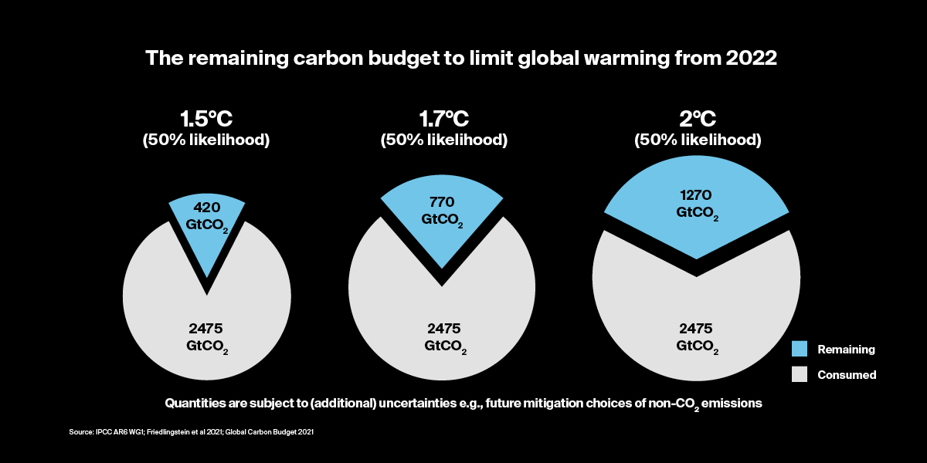
What is net zero?
Conserving the carbon budget

Slide 4
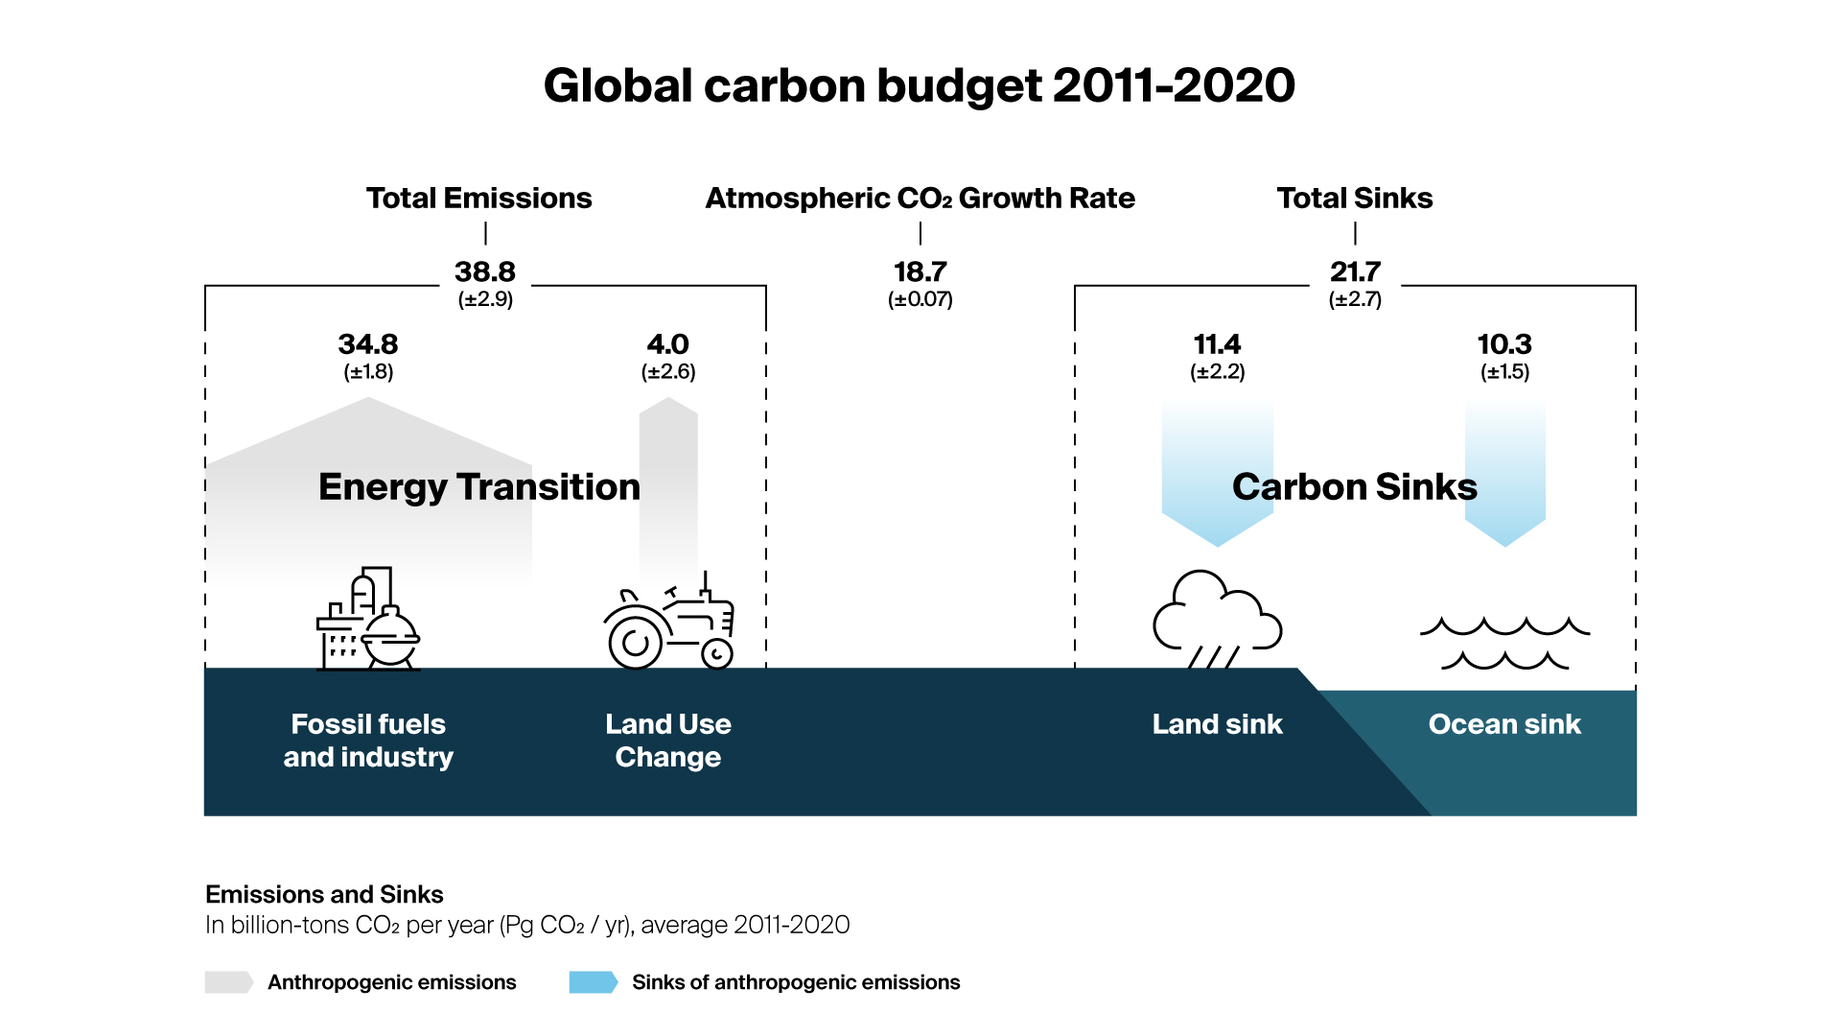
What is net zero?
Global carbon budget | emissions and sinks
Source Global Carbon Project

Slide 5
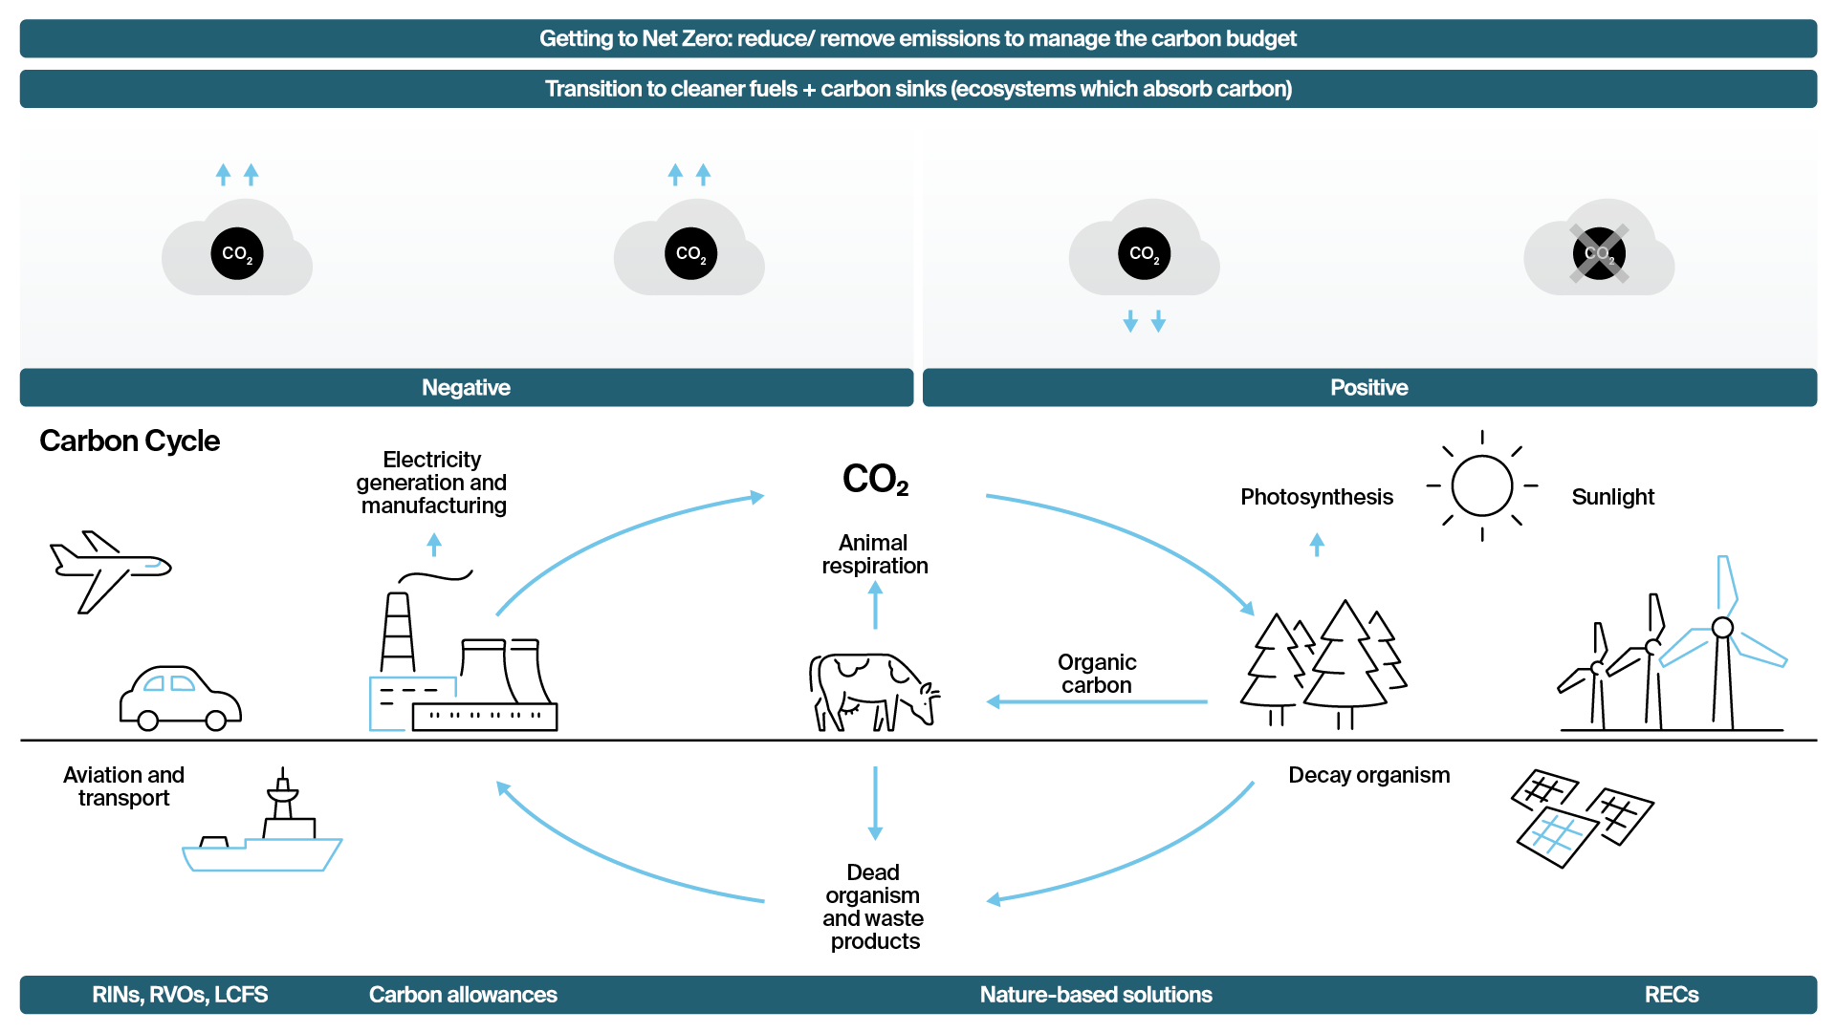
Environmental markets
Price signals to allocate capital across carbon cycle to conserve the carbon budget

Slide 6
Carbon tonnes at risk

Slide 7
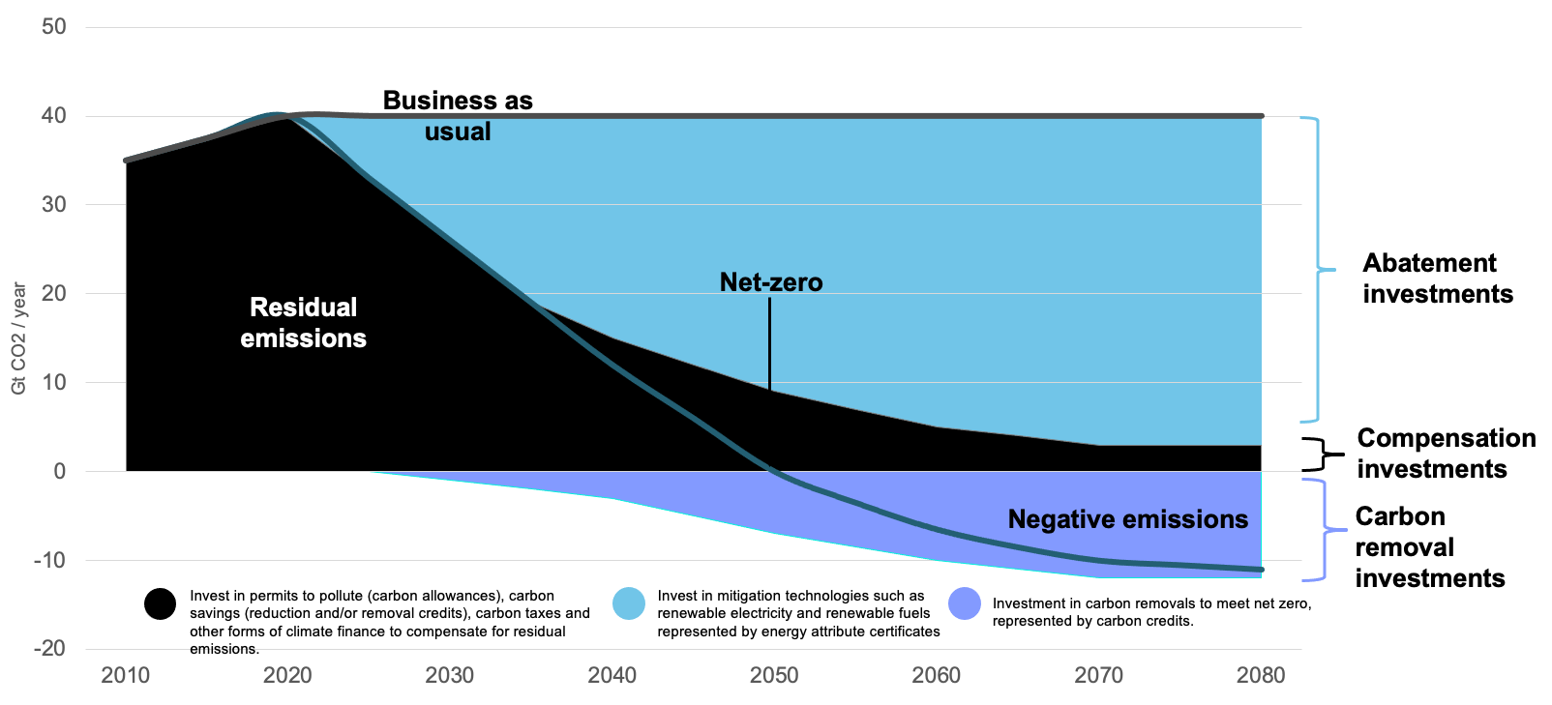
Carbon pricing and carbon tonnes at risk
Annual emissions and net zero pathway

Slide 8
Environmental markets today

Slide 9
Carbon tonnes at risk
Annual emissions, carbon tonnes at risk and trading volumes
8X
18% @ risk
2X
16
17
Sources: World Bank State of Carbon Pricing 2023; The CityUK Global Carbon Pricing Report; Shell/BGC The Voluntary Carbon Market 2022 Insights; ICE

Slide 10
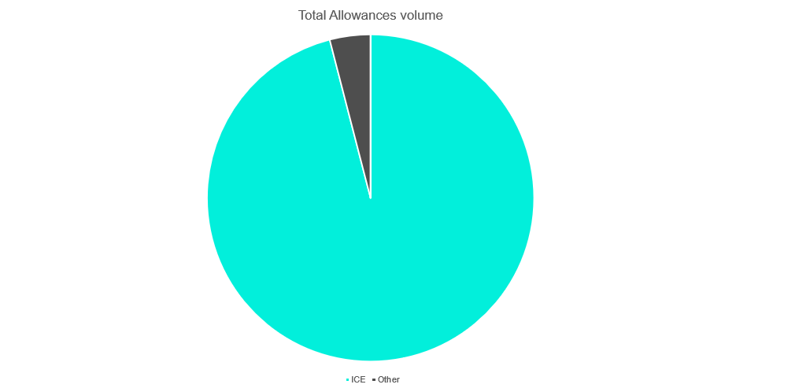
Compensation investments
Cap and trade and carbon crediting mechanisms
Sources: Shell/BCG; The Voluntary Carbon Market 2022 Insights; ICE

Slide 11
ICE is home to the world’s largest environmental markets
Connect to a global environmental portfolio to price climate risk
>50% of world’s annual emissions footprint equivalent traded on ICE
>115 billion tonnes of allowances equivalent to 3x world’s annual CO2 footprint
>350 million RECs
equal to the annual per capita energy consumption of nearly million people
$75B open interest
of environmental futures and options risk managed at ICE
$1T notional value of
environmental futures and options traded per annum since 2021
>5 billion RINs equal to
118 million barrels of renewable fuels
>6 billion tonnes of carbon credits corresponding to the Co2 absorption of 6 billion trees
2019 emissions per county/region in MtCO2 (sources: IEA, California ARB, RGGI)
Emissions traded on ICE in 2021 in MtCO2 (source: ICE)

Slide 12
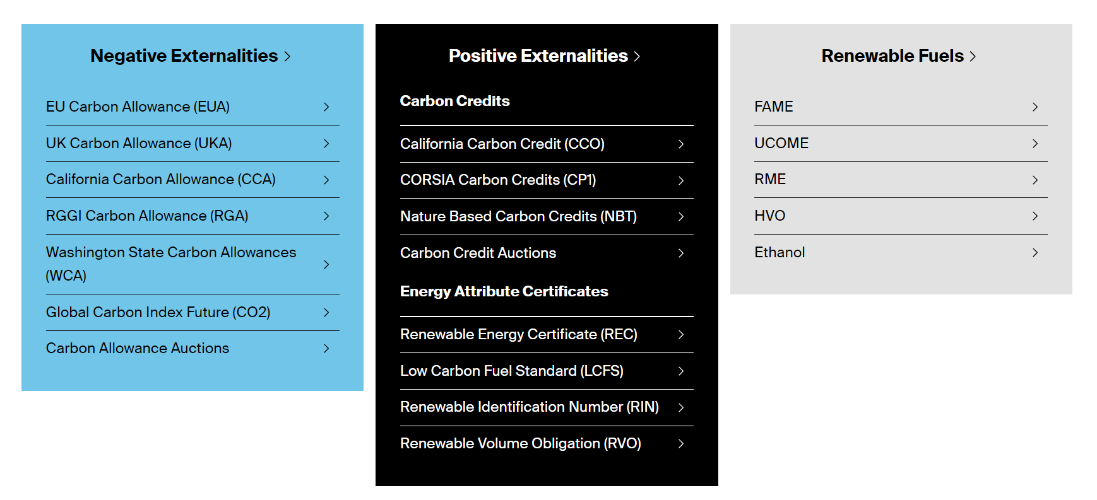
ICE host to the world’s largest energy & environmental markets
Connect to a global environmental portfolio to price climate risk
World’s first Paris Agreement aligned carbon credit futures contract
CORSIA Phase 1 launched 9 October 2023

Slide 13
Appendix

Slide 14
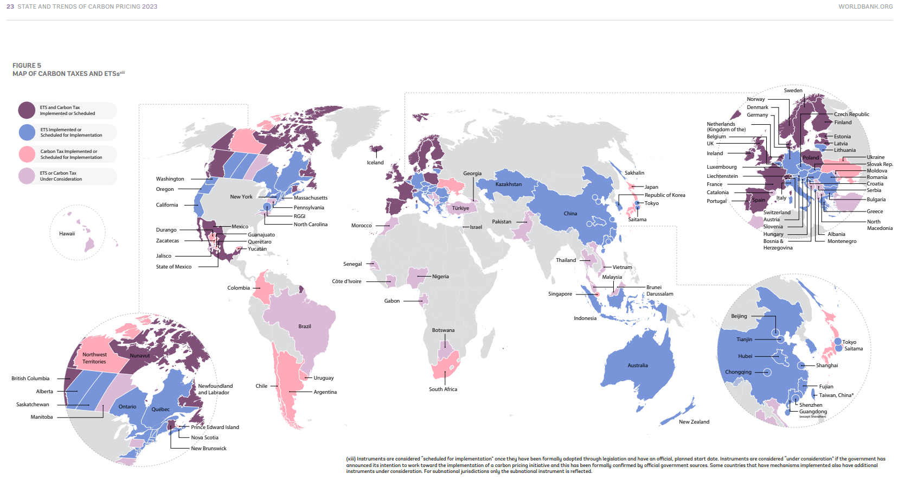
Carbon pricing map
ETS and carbon taxes

Slide 15
Regulated carbon markets
ICE hosts the three largest and most liquid carbon markets in the world
 | North America |  | Europe | UK
Name | Western Climate Initiative (WCI)¹ | Regional Greenhouse Gas Initiative (RGGI)² | European Emissions Trading System (EU ETS)³ | UK Emissions Trading System (EU ETS)⁴
Members | California and Quebec have a linked cap and trade program British Columbia, Nova Scotia | Connecticut, Delaware, Maine, Maryland, Massachusetts, New Hampshire, New Jersey, New York, Rhode Island and Vermont. Virginia joined in 2021 | All European countries plus Iceland, Liechtenstein and Norway (Switzerland is linked) | UK (4 Governments)
Start date | 2013 | 2008 | 2005 | 2021
Size of cap | 375 million allowances in 2021 | 71 million allowances in 2021 | 1,776 million allowances in 2021 | 155 million allowances in 2021
% emissions covered | 85% | 20% | 45% | 35%
Industries covered | Power sector, industry, distributed natural gas and fuels | Power sector | Power, industry, EU aviation | Power, industry, UK aviation
Supply / price management | Floor price (increase 5% + inflation) Allowance Price Containment Reserve (APCR) Price containment (ceiling after 2020) | Cost Containment Reserve (CCR) Emissions Containment Reserve (ECR) starts 2021 | Market Stability Reserve (MSR) | Floor price £22 Cost containment mechanism
Notional value ICE (2020) | 30 billion USD (+42.9%) 47 billion USD 2021 projection (+56%) | 1.5 billion USD (+0) 1.8 billion USD 2021 projection (+25%) | 308 billion EUR (+14.5%) 696 billion EUR 2021 projection (+125%) | GBP [-] 22 billion GBP 2021 projection
Churn (volume/cap*) 2020 [2019] *adjusted for MSR | 4.67 [3.61] | 4.1 [4.5] | 8.45 [7.85] | N/A [-]
Also referred to as California Cap and Trade. For more information see California cap & trade homepage
For more information see RGGI cap & trade homepage
For more information see European ETS Handbook
For more information see Participating in UK ETS

Slide 16
Carbonomics: UK Case Study
When the price of carbon is taken into account, it is less profitable to produce electricity from both coal and natural gas

Slide 17
Carbonomics: UK Case Study Outcome
Coal is removed from merit order of electricity generation
Source: Ofgem (2021), ‘Electricity generation mix by quarter and fuel source (GB)’, April

Slide 18
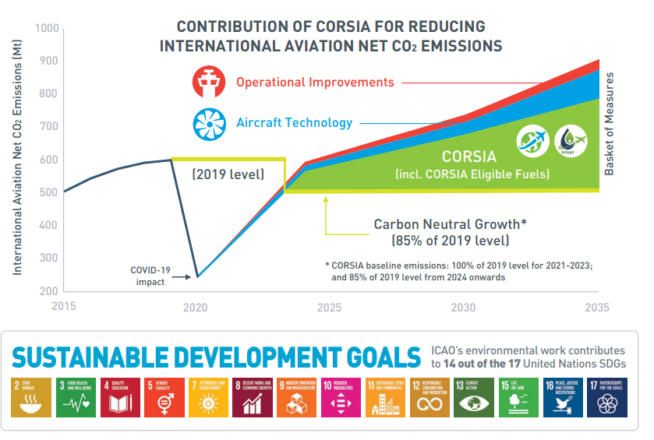
Carbon Offsetting And Reduction Scheme For International Aviation (CORSIA)
First global market-based measure
Part of basket of measures to offset emissions that cannot be reduced by operational improvements or Aircraft technology.
Pilot Phase 21-23 (Voluntary – 88 states)
First Phase 24-26 (Voluntary – 125 states)
Second Phase 27-35 split in 3 years compliance periods (27-29; 30-32, 33-35) – all states (with exclusions)
Baseline: 85% of 2019 level from 2024 onwards
Member states ensure compliance.

