Slide 1


The Future of UK Energy Policy
Michael G. Pollitt
Cambridge Judge Business School
and
Centre on Regulation in Europe
8 December 2023
EPRG Winter Seminar

Slide 2
Ideas on UK energy policy
Wholesale markets definitely work
Retail markets can work most of time
More locational pricing?
Prices vs quantities?
Getting the structures right
Offshore wind
Don’t be an energy island
2

Slide 3
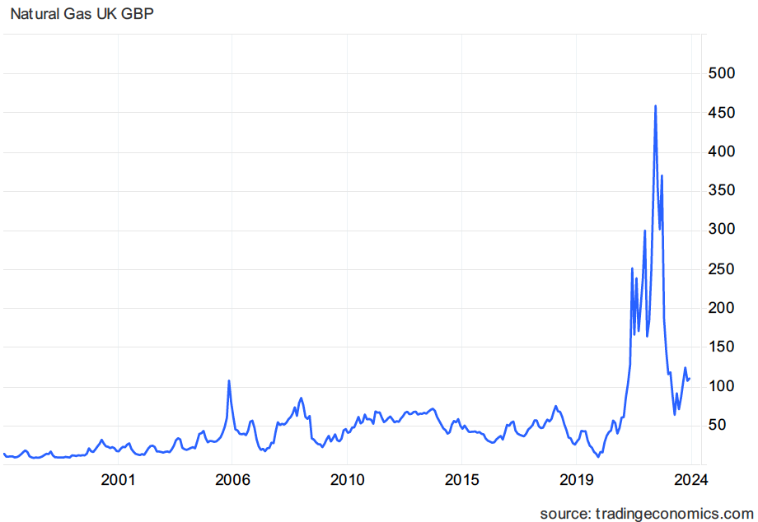
A remarkable stress test: wholesale natural gas prices reached historically unprecedented levels
GBP pence per therm
Price of 107p today (CPIH).
This is 86p in Jan 2018.
Jan 2018 it was 50p.
So, 70% higher
in real terms.
3

Slide 4
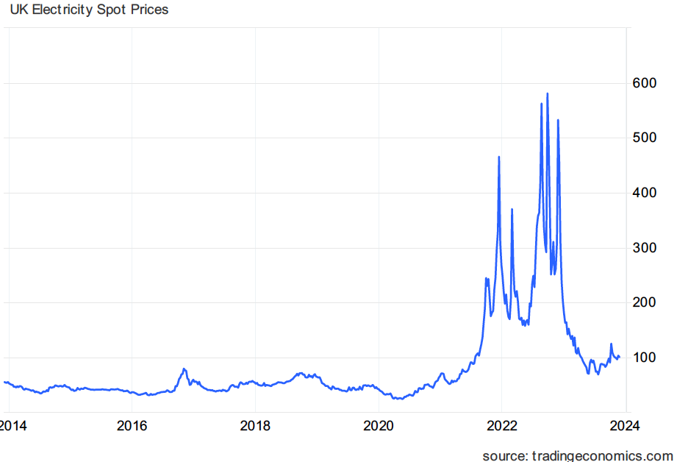
A remarkable stress test: wholesale electricity prices were at historically high levels
GBP £ per MWh
Price of £100 today
But £12 is higher carbon price;
£88 is price of £71 at
Jan 2018 CPIH, when monthly price was c.£51.
So, price is elevated by 40% in real, post-carbon cost.
4

Slide 5
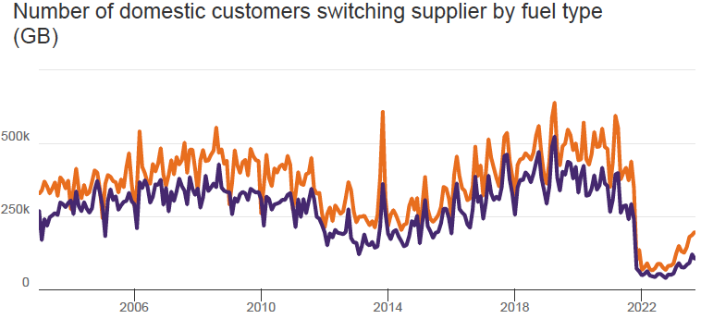
GB Retail switching has increased again…
Higher line = Electricity, Lower line = Gas
To August 2023 Source: Ofgem
5

Slide 6
LMPs for GB? FTI Report numbers revisited
FTI numbers are in
Red. My numbers
are in Black.
We do need better locational signals.
LMPs as practiced in the US are a pre-energy transition system focused on
transmission with limited evidence on their social welfare effects in use, we need to
better understand their efficiency, market power and risk trade-offs.
See: Pollitt, M.G. (2023b), Comments on the FTI Report on Assessment of locational wholesale electricity market design options in GB August 2023, 12 October 2023 p.9.
6

Slide 7


A hybrid market design? Its not just about prices…
(Pollitt, 2021)
Of course, the likelihood is that some sort of new hybrid market design might develop.
This would make use of some price-based elements, particularly towards non-energy ancillary services, and of non-price quantity based rationing.
One could imagine the default contracts being rationing contracts and these would exist on the basis of public desire for zero carbon energy systems.
Retailers or energy communities (such as exist in California or the EU) might provide power on this basis to their own customers, acting as intermediaries between price-based charging and quantity-based rationing.
Equally, we might imagine that households would have two contracts – one for basic service and one for EV charging.
7

Slide 8
Reorganising the industry for net zero?
The FSO is a start.
Gas and electricity networks in same area in same company?
NGET and NGGT?
Source: Bringing Energy Home, 2019, p.9.

Slide 9
Offshore Wind is key to UK and EU decarbonization,
so don’t stuff up auction design
Table. Capacity gaps towards the 2030 installation targets of North Sea countries (MW).
UK Case
Status | Capacity - GW
Seabed allocated | 89
In development | 52.6
Gap to 2030 | 21.9
Consented | 9.6
Need to consent | 12.3
Consent to commission for previous CfD projects | 7.17 years
The 12.3 GW need to be consented before | 2025
Winning CfD to commission | 4.86 years
The 21.9 GW need to win CfD before | 2026
Country | Installed capacity | Under construction | Pre-construction | 2030 targets | Gap | Pipeline
UK | 13,918 | 6,588 | 7,610 | 50,000 | 21,884 | 22,890
Germany | 8,055 | 733 | 2,042 | 30,000 | 19,170 | 18,748
Netherlands | 2,829 | 2,299 | 0 | 21,000 | 14,416 | 11,456
Denmark | 2,308 | 344 | 0 | 12,900 | 9,248 | 10,200
Belgium | 2,261 | 0 | 0 | 6,000 | 3,739 | 3,500
Sweden | 192 | 0 | 0 | - | - | 5,900
Norway | 6 | 0 | 0 | - | - | 2,000
France | 482 | 1,444 | 1,592 | 4,400 | 882 | 0
Source: Zhang and Pollitt, 2023, EPRG WP 2323.
9

Slide 10
UK energy and climate policy
should align with EU
The EU-UK Trade and cooperation agreement establishes a Specialised Committee on Energy (SCE) as part of implementation and functioning process.
Title VIII (Part 2) to the Agreement (The Energy Title) is one of the more detailed parts of the whole Agreement. At a high level it states that no tariffs can be imposed on exportation of electricity and gas by either party. The agreement is generally supportive of continuation of competitive markets and of not supporting renewable electricity (RES-E) in a way that would undermine competition. There must be monitoring of competition and an independent energy regulator. The agreement preserves the Single Electricity Market in Ireland (I-SEM).
This is up for re-negotiation in 2026.
We should argue for:
  Continuation of current arrangements as baseline.
  Re-entry into EU ETS I and entry into EU ETS II (and hence exemption from UK firms’ liability to CBAM).
  Re-entry into EUPHEMIA market coupling algorithm.
  Full membership of ACER, ENTSO-E, ENTSO-G.
10

Slide 11
Bibliography
FTI Consulting and ES Catapult (2023a), Locational pricing assessment in GB: Final modelling results, Presentation to Stakeholders Workshop 3, FTI Consulting, 6 June 2023, London and 13 June, Glasgow.
FTI Consulting and Energy Systems Catapult (2023b), Assessment of locational wholesale electricity market design options in GB, October 2023. London: FTI Consulting.
Pollitt, M.G. (2023a), Locational Marginal Prices (LMPs) for Electricity in Europe? The Untold Story, EPRG Working Paper No.2318.
Pollitt, M.G. (2023b), Comments on the FTI Report on Assessment of locational wholesale electricity market design options in GB August 2023, 12 October 2023.
Pollitt, M.G. (2023c), Energy Markets Under Stress: Some Reflections on Lessons From the Energy Crisis in Europe, EPRG Working Paper No.2317.
Pollitt, M.G. (2021), ‘The Future Design of the Electricity Market’ in Glachant, J-M., Joskow, P. and Pollitt, M.G. (eds.) Handbook on Electricity Markets, Cheltenham: Edward Elgar, pp.428-442.
Zhang, H. and Pollitt, M. (2023), Comparison of policy instruments in the development process of offshore wind power in North Sea countries, EPRG Working Paper No.2323.

