Slide 1

The future of UK energy policy: the net zero challenge
Donna Leong – Director of Analysis
Department for Energy Security and Net Zero
8 December 2023
***Official – Not Government Policy***
Please do not quote without author’s permission

Slide 2
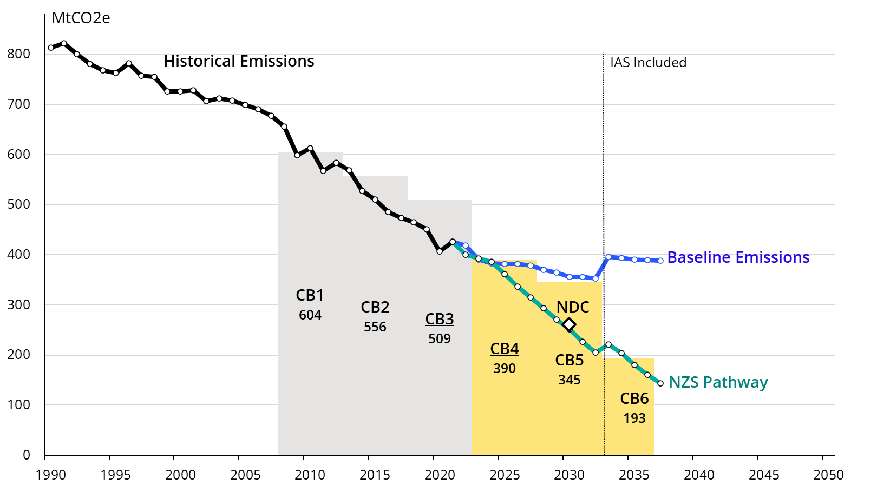
UK’s climate change targets are ambitious
Decarbonisation: UK has met Carbon Budgets 1, 2 and 3 comfortably but targets will tighten.
1
Carbon Budgets
We have legally binding 5-year Carbon Budget targets.
The latest target CB6 (2033 -2037) requires a 77% reduction in emissions from 1990 levels.
Nationally determined contribution
The Nationally Determined Contribution (NDC) is a separate target for 2030, as part of the Paris Agreement. Our current NDC represents a 68% reduction from 1990 emission levels.
**NZS Pathway was set in 2021 as part of the Net Zero Strategy publication. This has been adjusted to account for the latest EEP and GHG inventory

Slide 3
Energy trilemma adds challenge – but transition will also bring opportunities
Cost: CCC estimate that an additional £40-60bn is required per annum for the NZ transition
Security: renewables offer energy security and help combat fossil fuel price driven inflation – but require additional flexible supply
2
3
Capital Investment (£bn/year)
Hourly Wholesale Electricity Prices in the EU in the 1H 2022
High shares of renewables in electricity supply drove down wholesale electricity prices, while high shares of natural gas pushed them up.
€ per MWh
IEA analysis based on data from the ENTSO-E Transparency Platform, 2022.

Slide 4
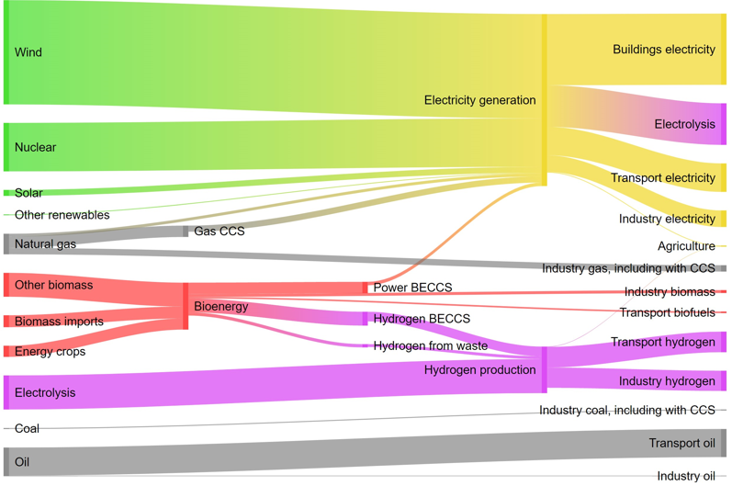
What does the decarbonisation pathway look like?
Energy generation and end uses in 2019 – still largely fossil fuels
High electrification Net Zero scenario: energy generation and end uses in 2050
1
2

Slide 5
Delivering Net Zero is a x-government systems challenge
Influencing Others (Int’l Stakeholders, Unions & ALB)
e.g., FCDO, DBT
Regulatory framework
e.g., OFGEM
Land Use & Agriculture
e.g., DEFRA
Fiscal incentives
e.g., HMT
Net Zero
by 2050
Infrastructure
e.g., DfT, DLUHC, DSIT, MoD
Greener Choices
e.g., Defra, DLUHC, DfT, DfE, DCMS
Engaging Businesses
e.g., DBT, DSIT, DfT, Defra, HMT, DCMS, DHSC, DfE
Technology and Business Model Success
e.g., DSIT, DBT

Slide 6
The Net Zero Strategy and Carbon Budget Delivery Plan provide a Road Map to meet these targets
190 polices across all sectors can be mapped into 6 key priorities:
Transform the Power System
Electrify Large Parts Of The Economy
Improve Resource & Energy Efficiency
Develop Alternative Low Carbon Technologies Where Hard To Electrify
Address Land Use & Agriculture Emissions
Develop Negative Emissions Technologies

Slide 7

What are we focusing on over the next few years – an illustrative timeline
DESNZ Milestones
Solar
Roadmap
Aim for Sizewell C FID by the end of this Parliament
2GW H2 production capacity by 2025
Hydrogen For Heating Decision
CB7 (2037 - 2042) Statutory Deadline To Be Set
Aim to deploy the first CCUS clusters in the mid-2020s
REMA 2nd Consultation
AR6 contracts
NDC (2035) Set
External Milestones
2H 2023
1H 2024
2H 2024
1H 2025
2H 2025
1H 2026
2H 2026
ZEV Mandate Introduced
CCC CB7 Advice
Future Homes Standard Starts
CCC Progress Report
CCC Progress Report
CCC Progress Report
COP28
COP29
COP30
COP31

Slide 8
What are we focusing on over the next few years – REMA
First announced in April 2022 in the British Energy Security Strategy, the Review of Electricity Market Arrangements (REMA) is a major review into the design of Britain’s electricity market.
Objective: To identify and implement the reforms needed to electricity market arrangements, to drive the necessary investment in, and efficient operation of, a secure, low carbon electricity system by 2035 whilst ensuring affordability for consumers and attractiveness for investors.
Scope: REMA considers options for long lasting reforms to all electricity (non-retail) markets and covers policies including investment and market operation.
April 2022:
REMA announced in the British Energy Security Strategy
July 2022:
First public consultation launched
As soon as possible:
Second public consultation launched
March 2023:
Summary of responses published

Slide 9
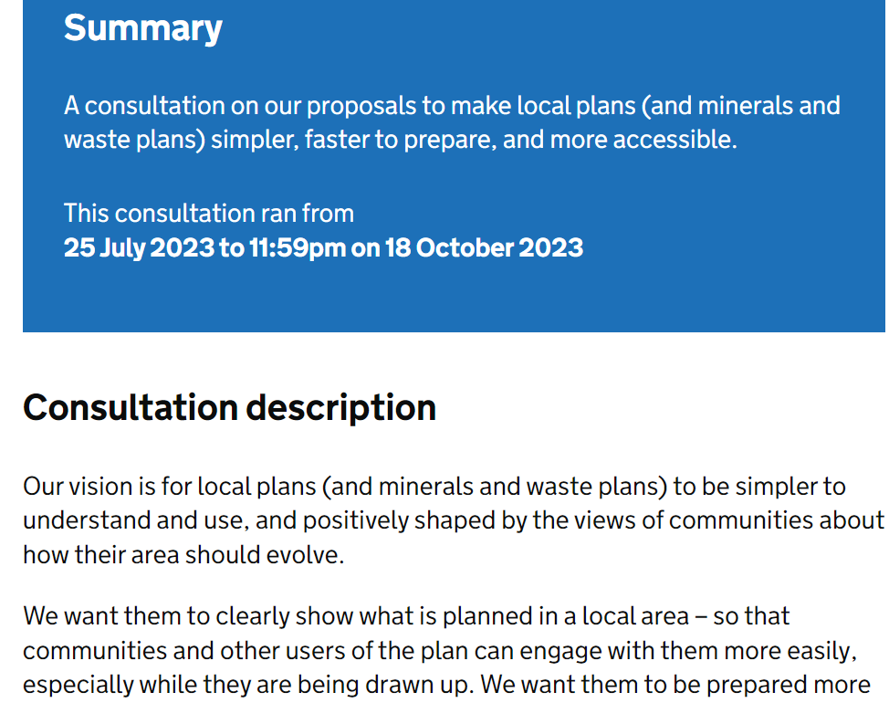
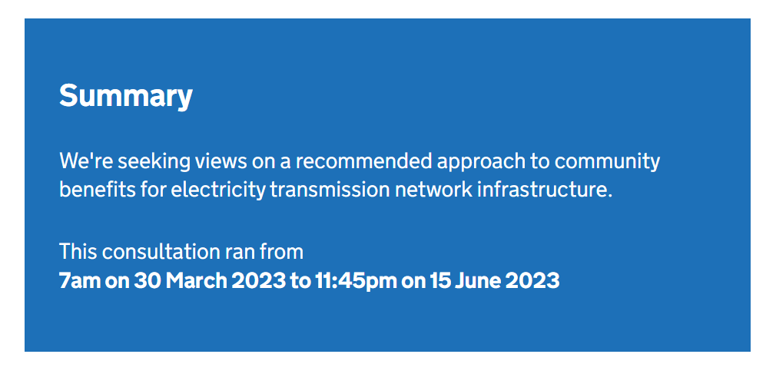
What are we focusing on over the next few years – Strategic Spatial Plan

Slide 10
Future collaboration
Discussion:
How can our analysis be bolstered by the work of the wider community?
Can we collaborate in a more structured way?

Slide 11
The end

